Slide 1
Select Split Transform Data Manipulation
Data Sets
cs2m
grades
mtcars
preg
t

Slide 2




Slide 3
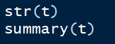
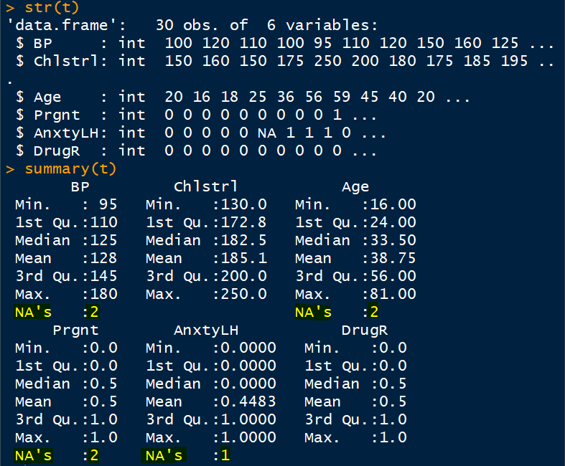
Complete Cases
Total 7 missing values

Slide 4
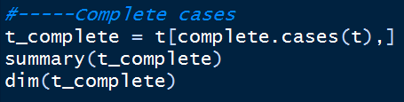
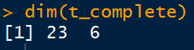
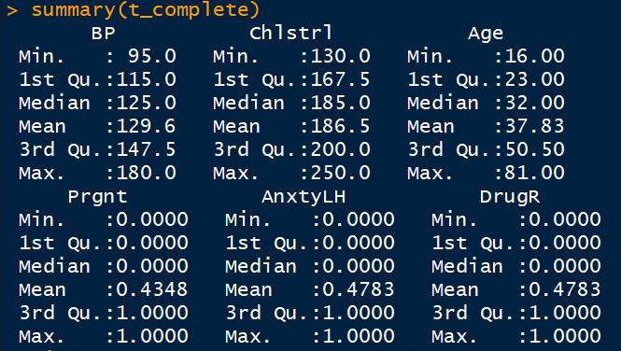
complete.cases
30-7 = 23

Slide 5
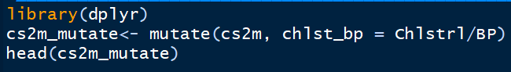
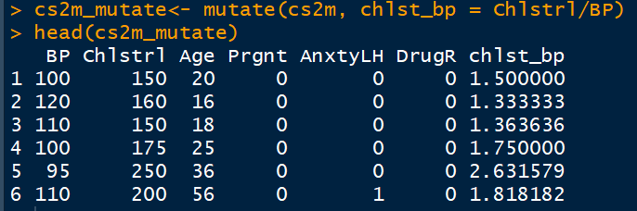
mutate →Creating new variable in data set [run library(dplyr) first]
If you write cs2m, left side, a new variable will be created in the original data set
New df

Slide 6
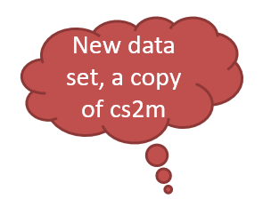
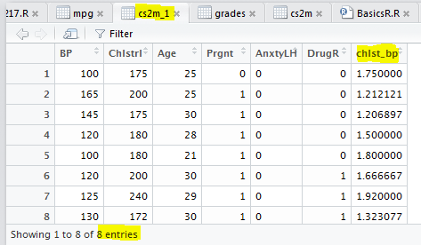
Create new variable by another method
Name of new variable after $ sign
New data set, a copy of cs2m
Values of new variable

Slide 7
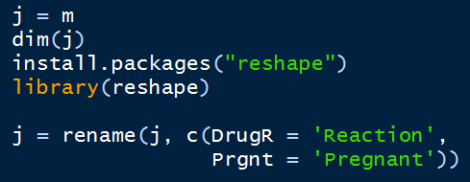
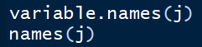
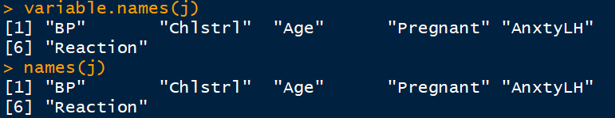
Change the name of variables DrugR to Reaction and Prgnt to Pregnant
j & m are nothing but cs2m file.
First write m = cs2m

Slide 8
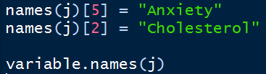
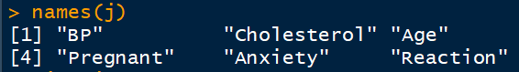
Using names() AnxtyLH to Anxiety Chlstrl to Cholesterol

Slide 9
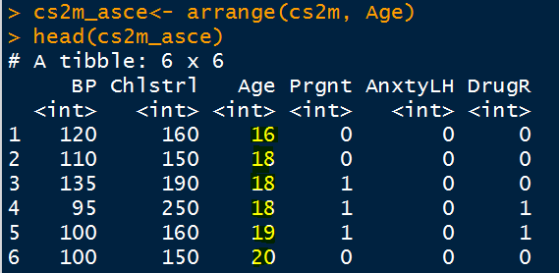
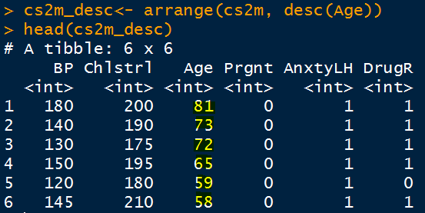
arrange
By default ascending order (low to high)
For Descending order (High to Low), need to specify

Slide 10
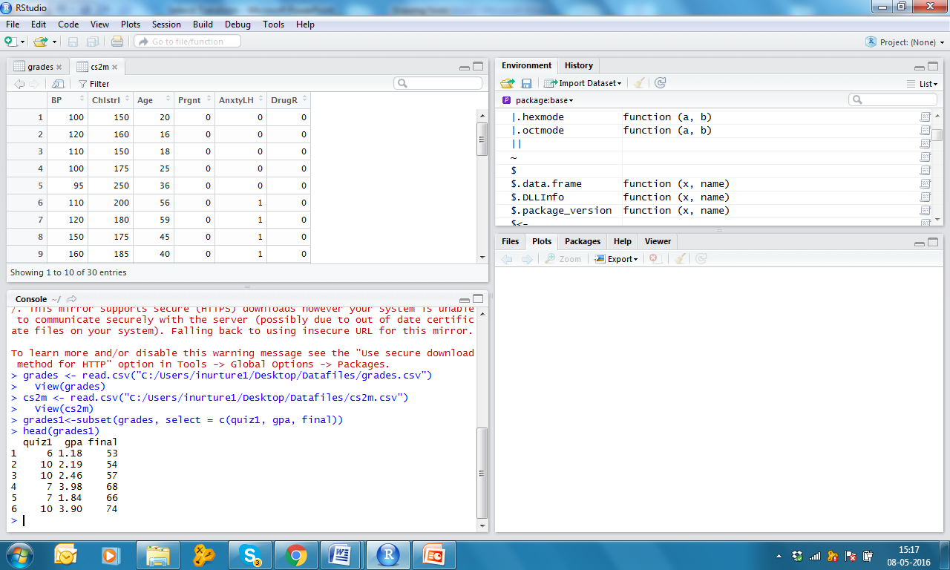
Select only quiz1, gpa & final and view few top rows
select = c(…
c is for concatenate

Slide 11
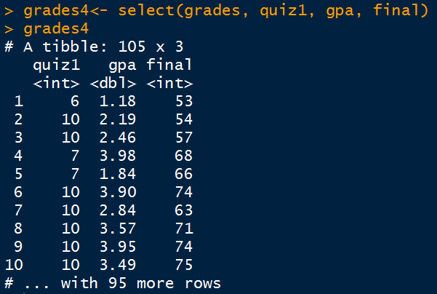
Much easier way!

Slide 12
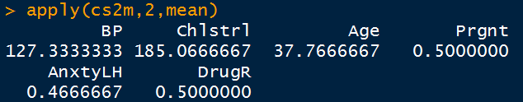
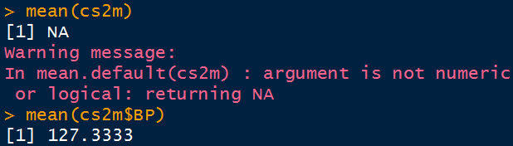
apply → column MEANS
2 stands for columns

Slide 13
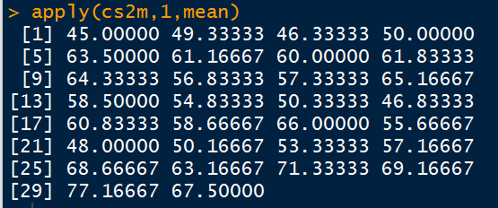
apply → row MEANS
1 stands for rows
This makes no sense

Slide 14
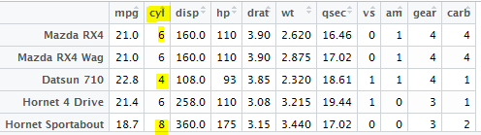
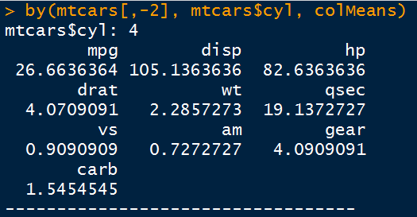
Average of all columns by cylinder
See what is at 2nd number in data, cyl, you donot want this to be averaged
4th cylinder

Slide 15
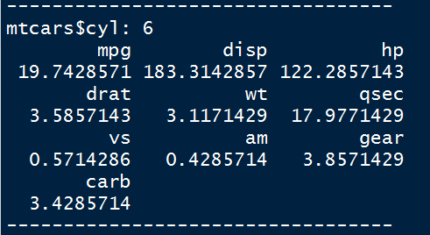
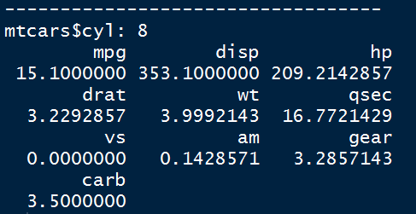
Average of all columns by cylinder
6th cylinder
8th cylinder

Slide 16
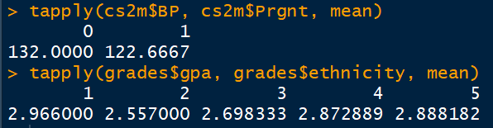
One Variable’s mean across a categorical variable

Slide 17
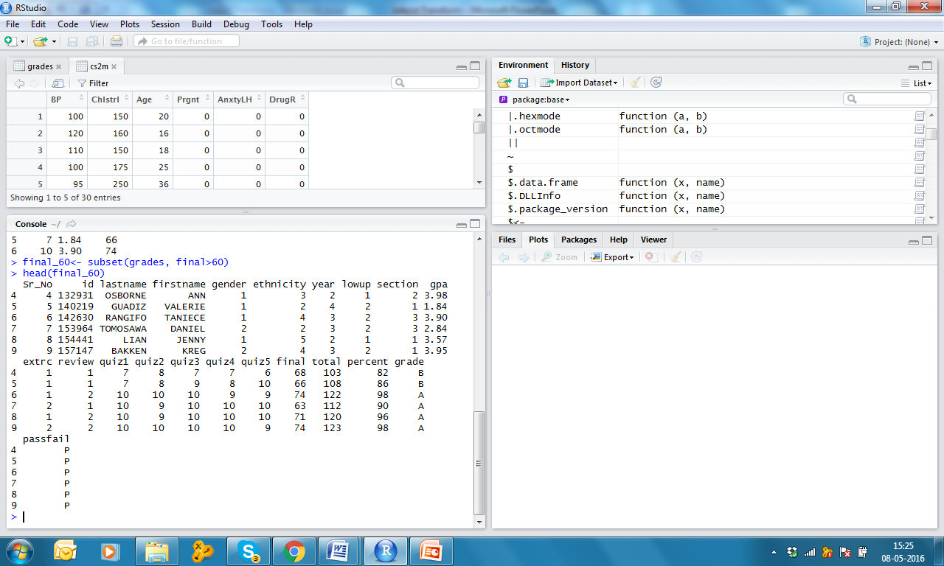
Select only final > 60 and view few top rows
Mathematical argument

Slide 18
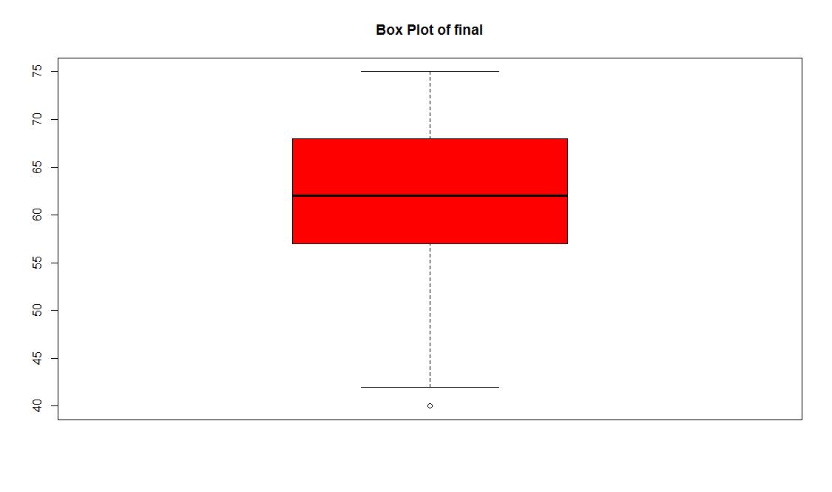
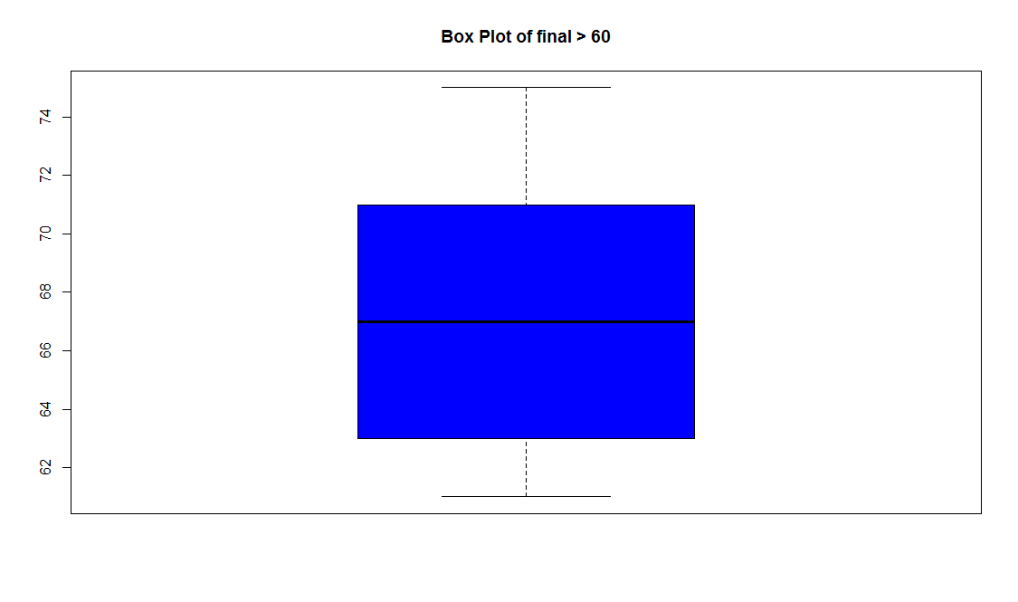
Compare box plots of final of all 105 observations and with final>60
> boxplot(grades$final,
main = "Box Plot of final",
col="red")

Slide 19
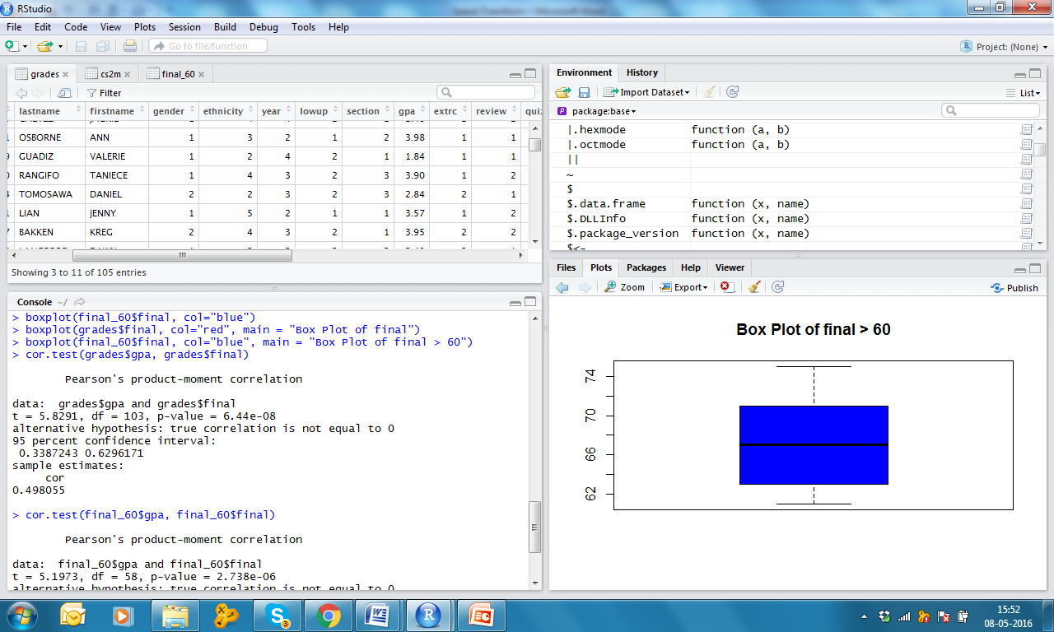
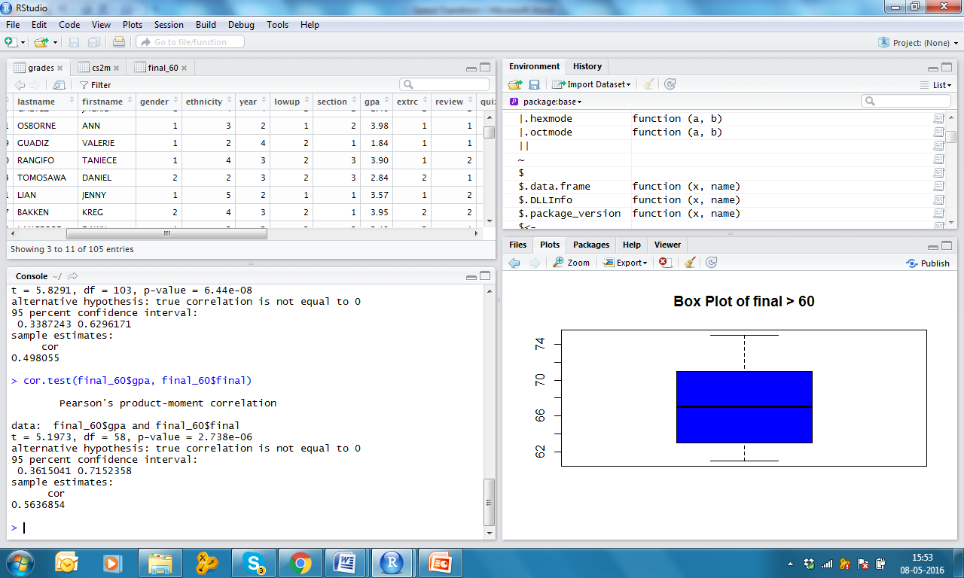
Compare correlation between final and gpa in all 105 observations and in subset final > 60

Slide 20
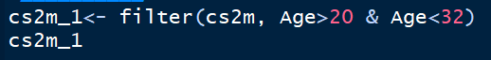
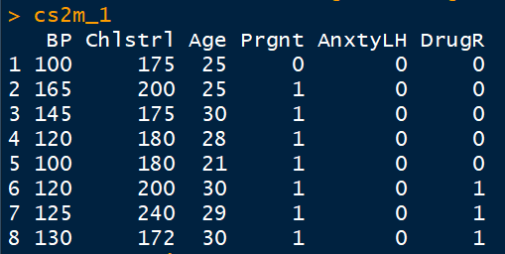
cs2m file; Age between 20 & 32 filter

Slide 21
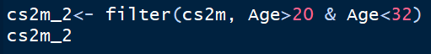
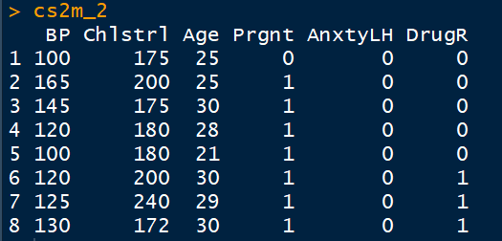
cs2m file; Age between 20 & 30 subset

Slide 22
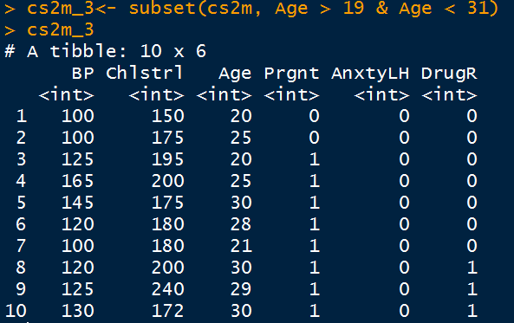
You can use subset with small change!

Slide 23
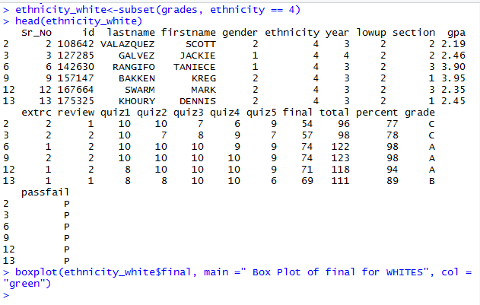
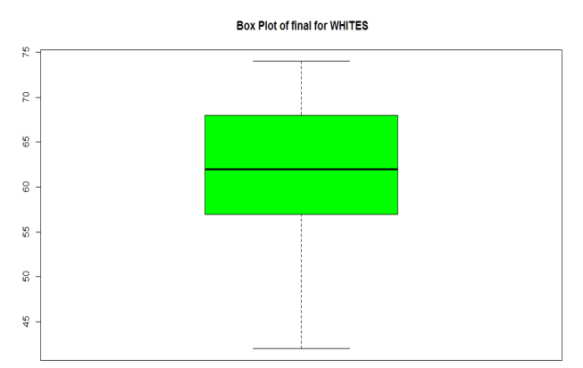
Create subset of only WHITES (ethnicity = 4) and view few top rows and make box plot of final

Slide 24
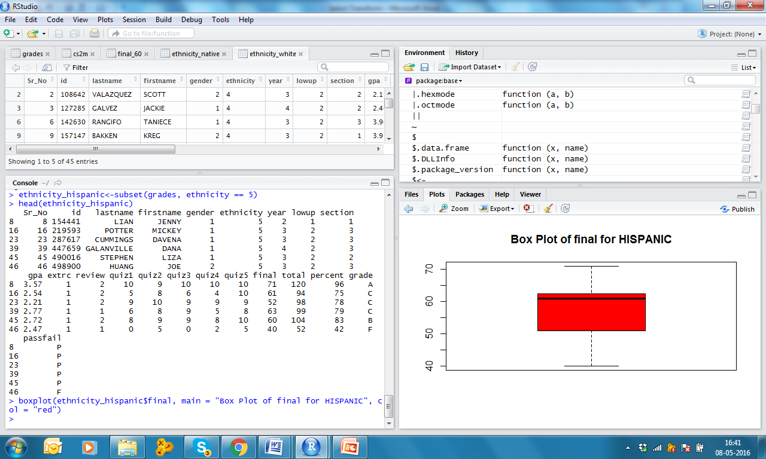
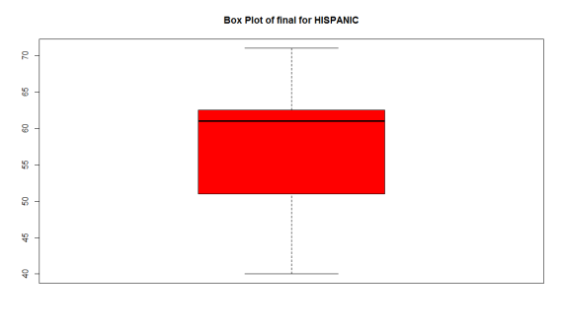
Create subset of only HISPANICS (ethnicity = 5) and view few top rows and make box plot of final

Slide 25


Compare box plots of final for WHITES and HISPANIC

Slide 26
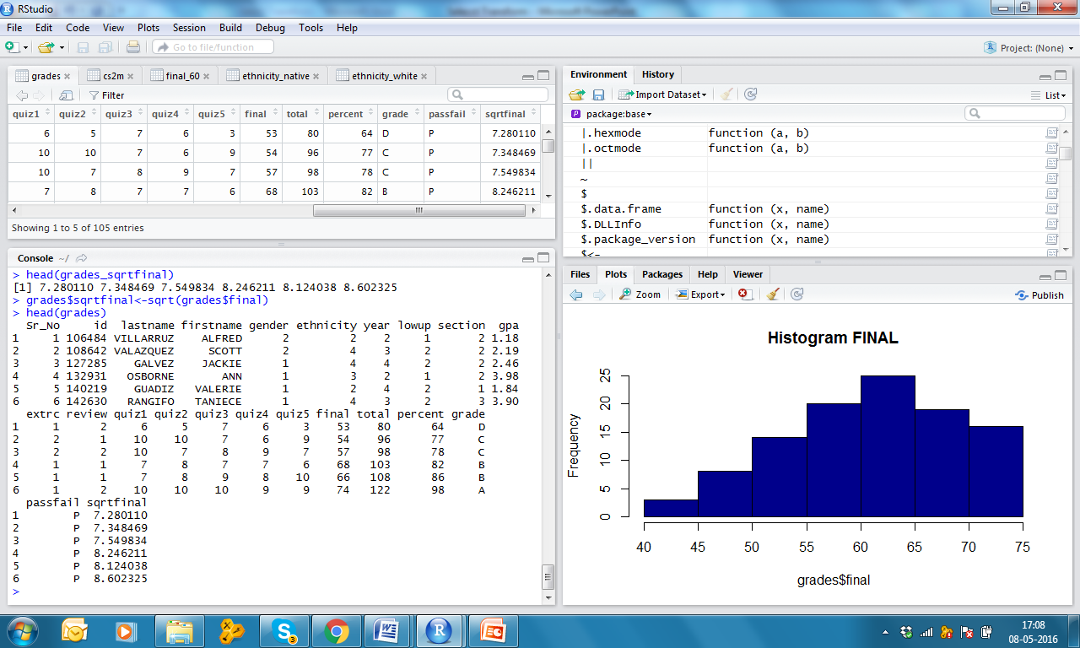
Transform final with square root and recode as new variable
c
c
c

Slide 27
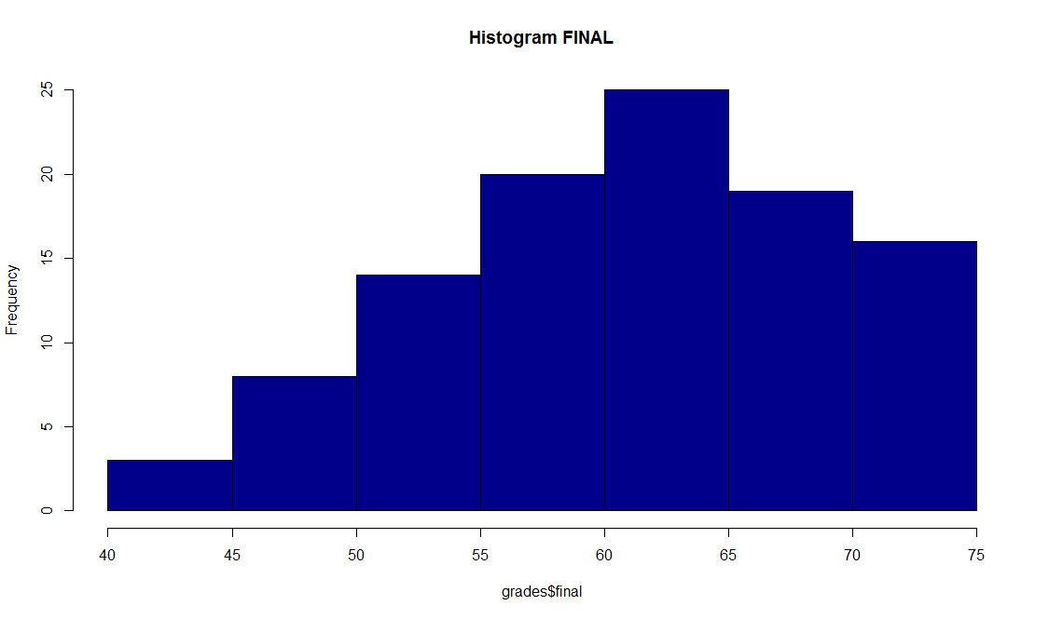
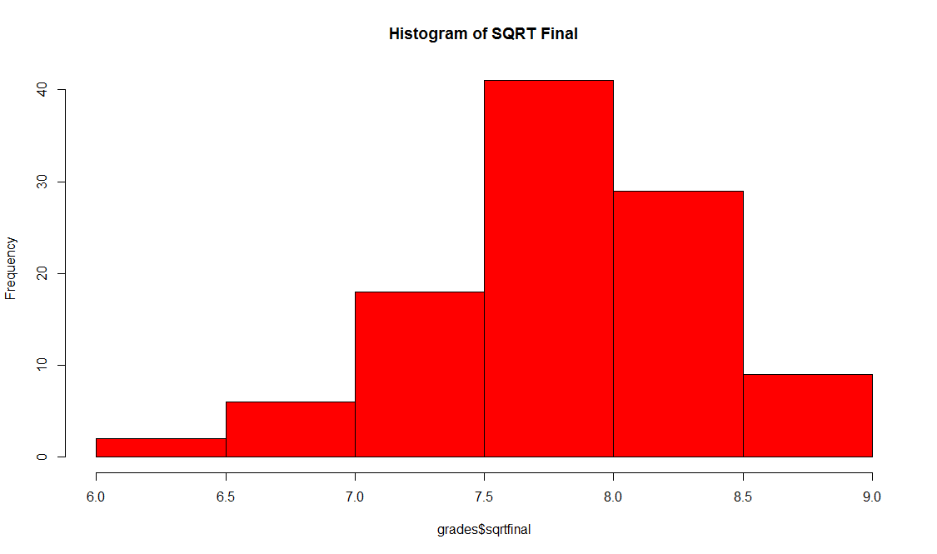
Compare Histograms of final and sqrtfinal
Final: skewness = -0.33 ; kurtosis = -0.42
Sqrtfinal: skewness = -0.48 ; kurtosis = -0.17

Slide 28
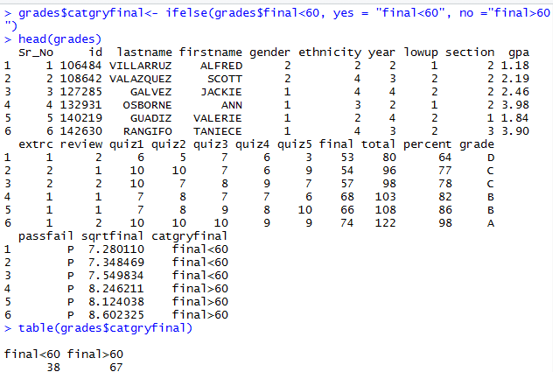
Convert final into two categories of final [one, <60 and second >60, 60 will fall in > 60]

Slide 29
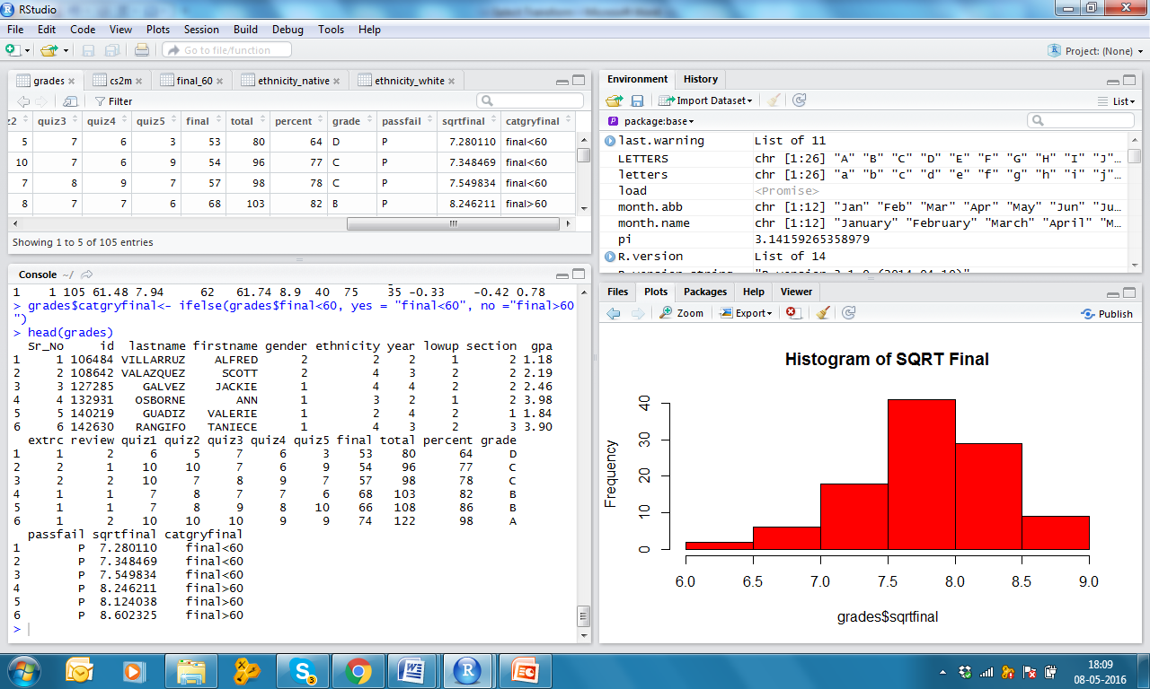
Convert final into two categories of final [one, <60 and second >60]

Slide 30

Convert final into categories with increment of 5 [40-45=1, 46-50=2, 51-55=3, 56-60=4, 61-65=5, 66-70=6, 71-75=7]
cut command

Slide 31
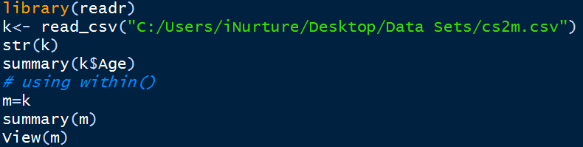
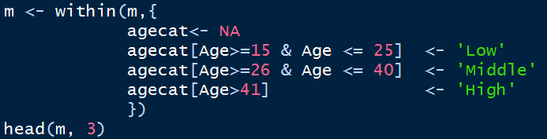
within() Create new variable catage as categories of Age
within command

Slide 32
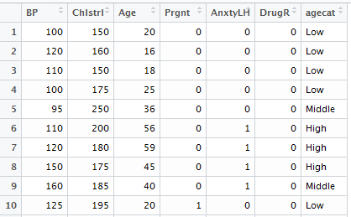

Slide 33
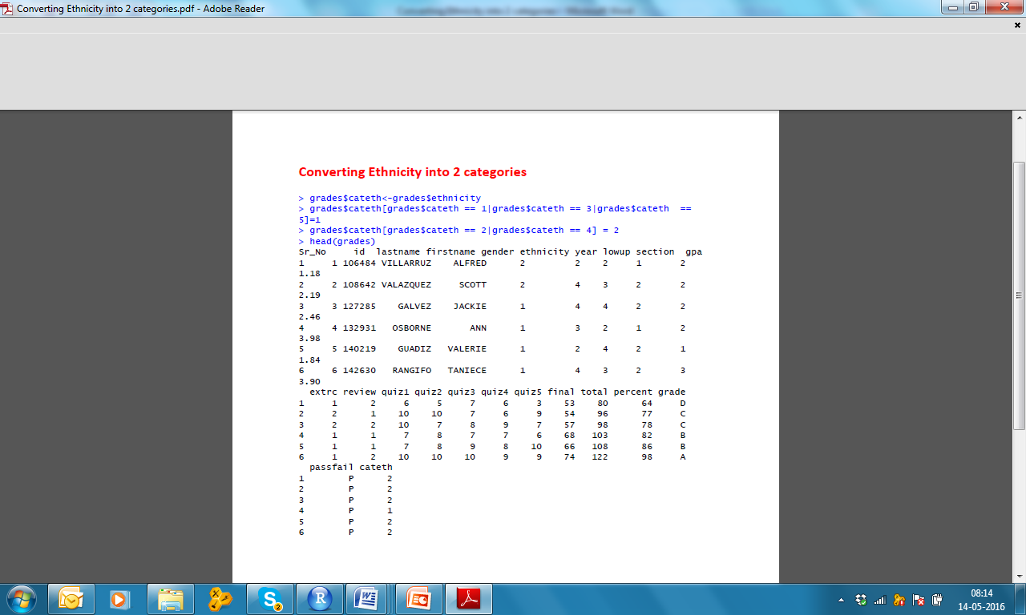
Converting ethnicity into two categories [category 1= 1, 3& 5; category 2 = 2 & 4

Slide 34
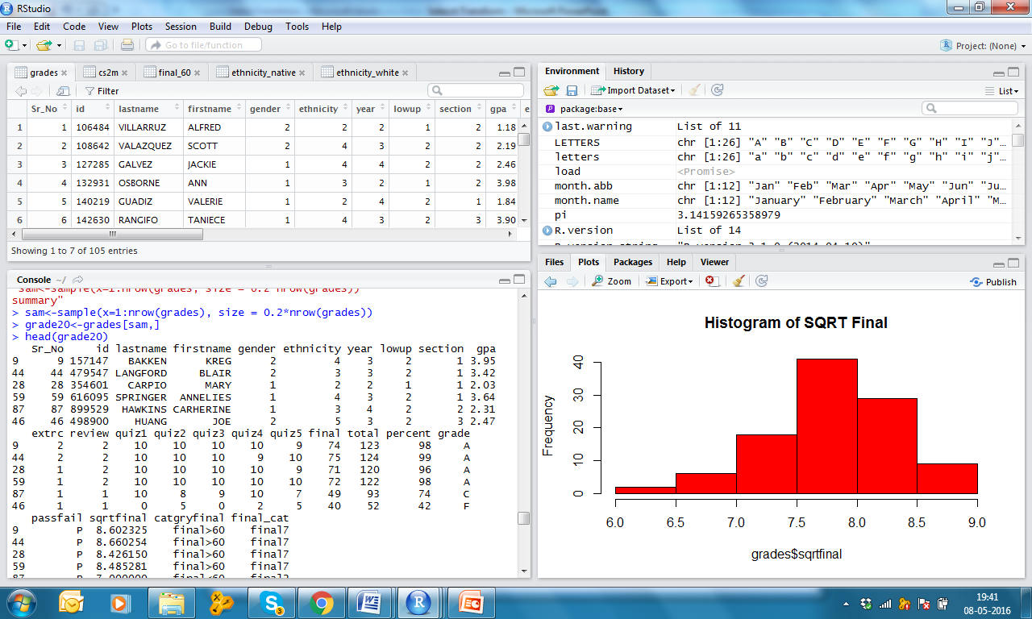
Take out 20% observations randomly from the file grades

Slide 35

All 20% cases [21#]

Slide 36

Case numbers

Slide 37


summarize
Sometimes you need to see few statistics only of your choice!

Slide 38



Pipe for doing many things in one go
cs2m data set is input for filtering
Filtered data is input for select operation
Selected data only mutated for new variable

Slide 39



Pipe for doing many things in one go
Knowing statistics of your choice, group wise

Slide 40


Pipe for doing many things in one go
Think backward, you wanted to know average final and average gpa, gender & ethnicity wise!

Slide 41



Pipe for doing many things in one go
But wanted to have average gpa > 2.25 only

Slide 42


Aggregation and Filter
Need package dplyr

Slide 43


Lets learn some automation
Task = write No for Not Pregnant and Yes for Pregnant

Slide 44



Lets learn some automation
Task = Do the same for Anxiety and Drug Reaction also in one attempt!

Slide 45

Lets learn some automation
Small i stands for column
x[i] == 2 means there are only 2 unique values in the column like 0 and 1
Small x stands for individual values in a column

Slide 46


Lets learn some automation

Slide 47



Data Cleaning tidyr

Slide 48

gather arrange

Slide 49

gather arrange
Adding n is immaterial

Slide 50

Can we write ‘a’ for treatmenta and ‘b’ for treatmentb

Slide 51




Slide 52


